Slide 1
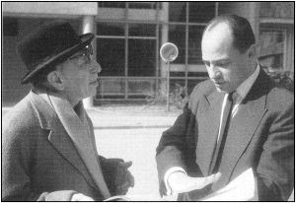
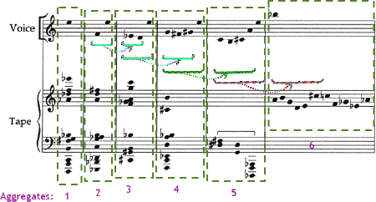
Twelve-tone Analysis

Slide 2
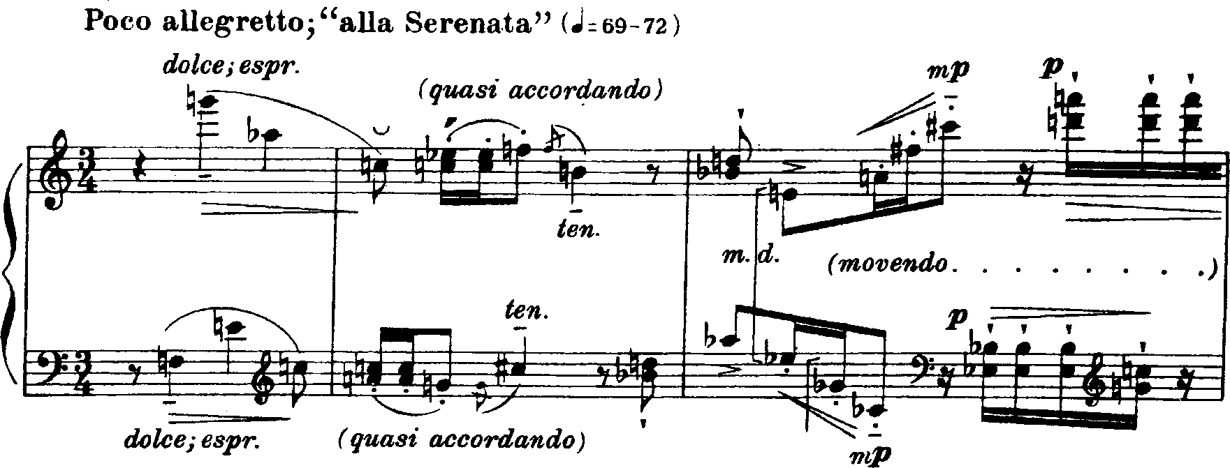
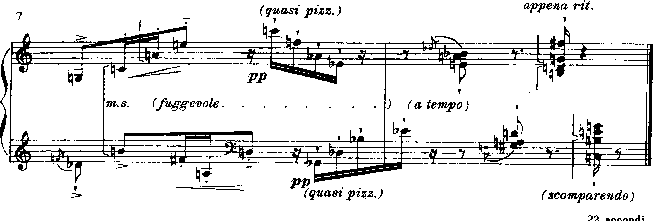
Dallapiccola “Contrapunctus secundus,”
mm. 7-8
mm. 1-3
mm. 4-6

Slide 3
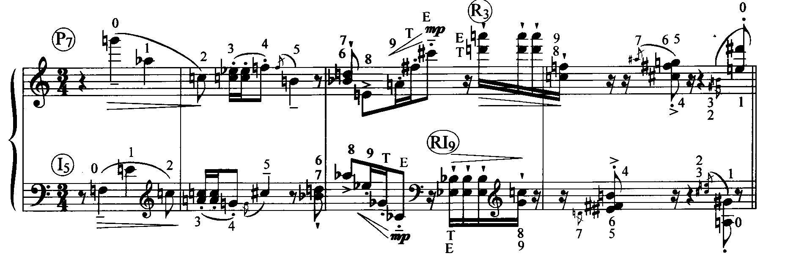
Dallapiccola “Contrapunctus secundus,” mm. 1-4

Slide 4
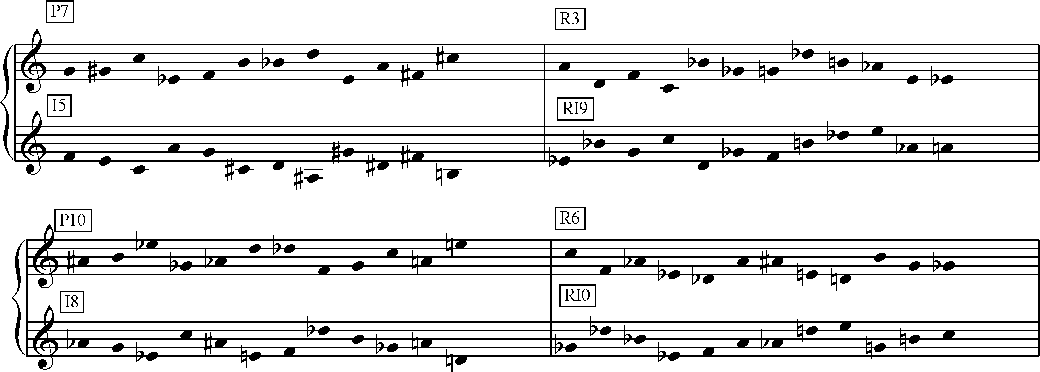
Dallapiccola “Contrapunctus secundus,” row forms
Axis C-F#
R₆ - R₁₀ begin/end C-F#
Axis E^{b}-A
R₃ - R₉ begin/end E^{b}-A

Slide 5
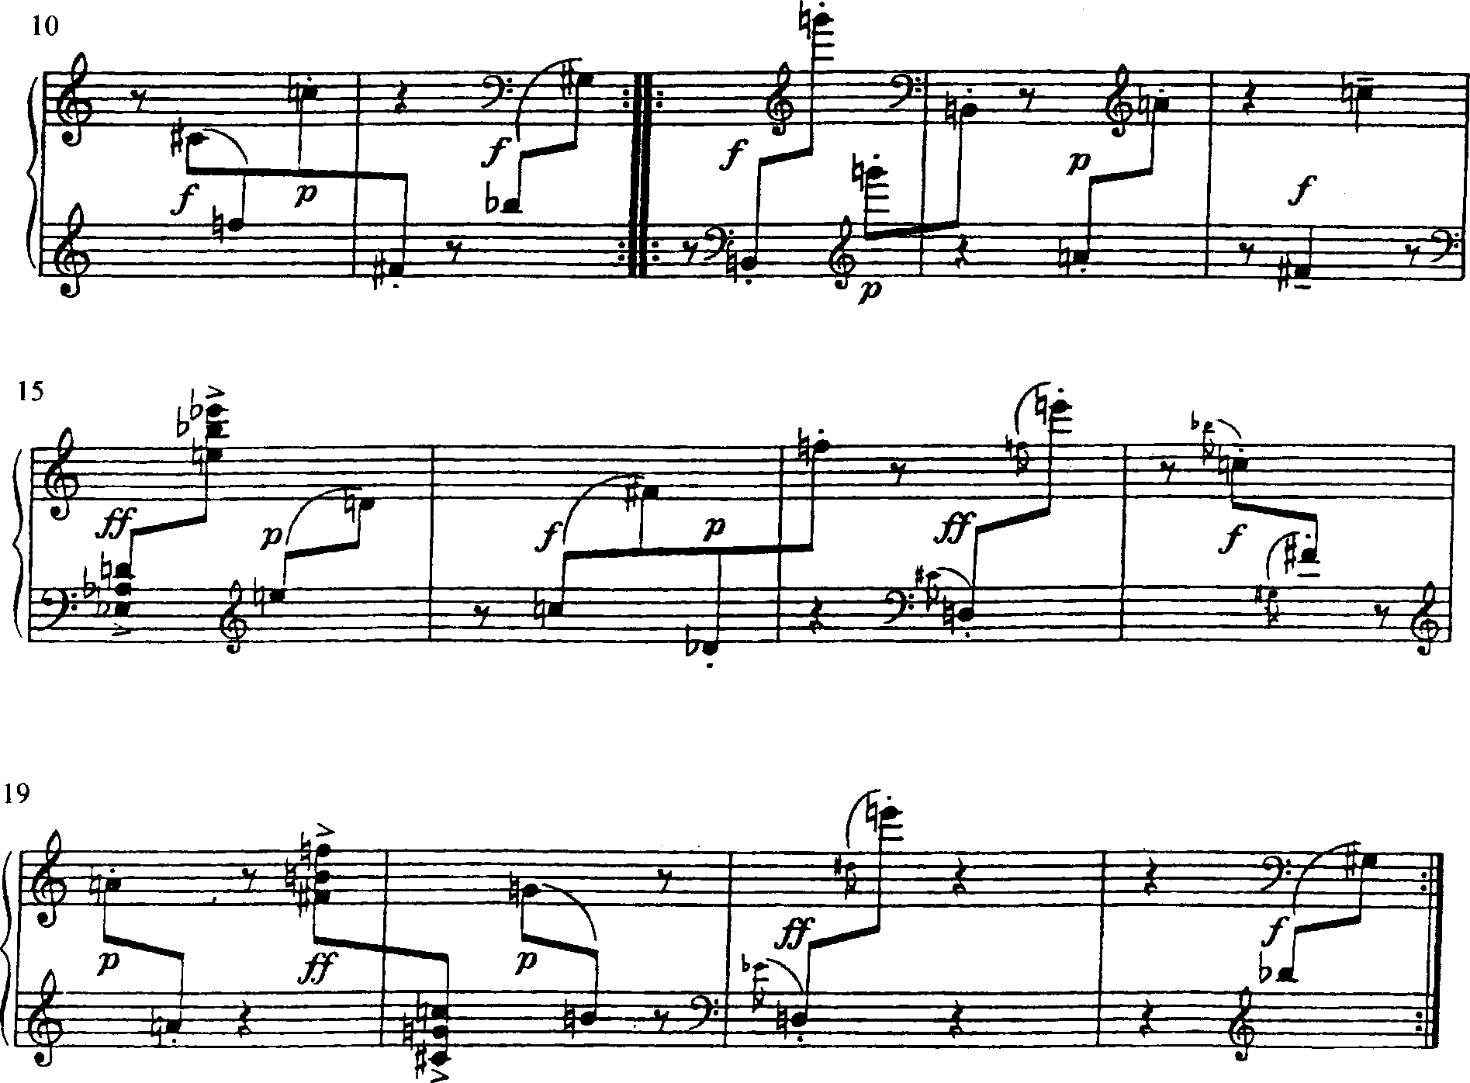
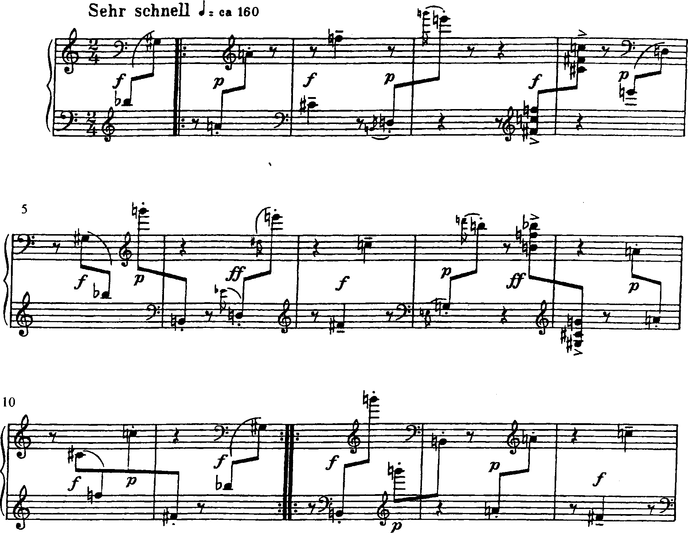
Webern, Variations, op. 27, ii

Slide 6
op. 27 row
3,E,T,21, 0, 6, 4, 7, 5, 9, 8
AIS: 9-11-4-11-11-6-10-3-10-4-1
discrete trichords
[TE3] [012] [467] [589] (015) (012) (013) (015)
discrete tetrachords
[TE23] [0146] [5789] (0145) (0146) (0124)
discrete hexachords
[TE0123] [456789] (012345) :)
D#, B, A #, D, C #, C, F #, E, G, F, A, G #
What properties can you locate in this row?

Slide 7
